Slide 1
(Note)
Outline:
Intro
Top busy stations
Tech companies/universities
High income neighborhood
Final target stations
Target hours - execution suggestion (Conclusion)

Slide 2

WomenTechWomenYes Annual Gala
Recommendations to Optimize Street Team Engagement

Slide 3
Goal
Get the Women Tech Women Yes street teams maximum engagement with target audience for fundraising effort.

Slide 4
Methodology
Where?
Stations closest to large tech companies and universities
High volume stations
When?
The busiest days at those stations
The busiest times of day

Slide 5










Who loves tech?

Slide 6
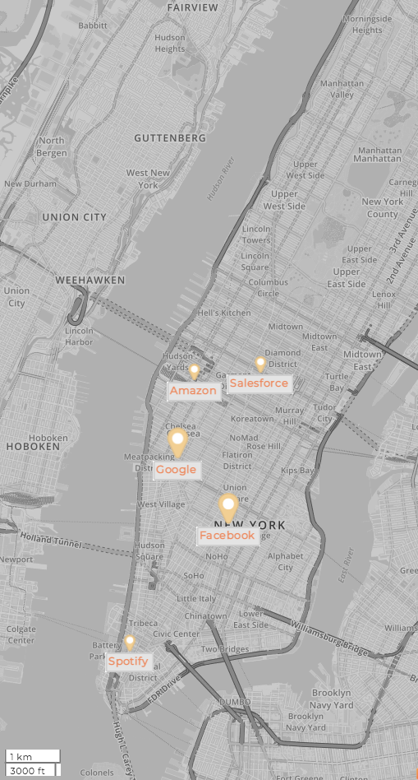
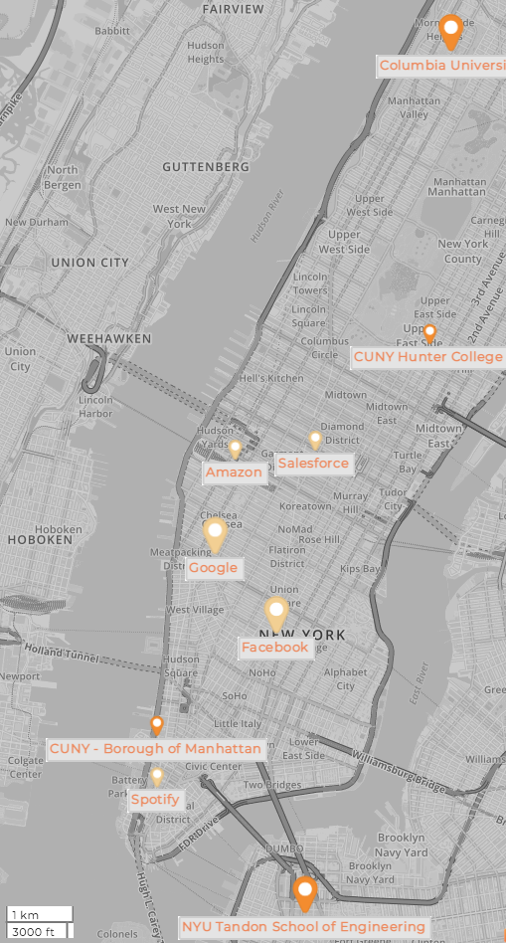

Slide 7
Who loves tech?
An alternative of slide 5+6, I don’t think we need an additional slide for the map of these companies/universities

Slide 8
Top busy stations
MTA average daily traffic for early summer in 2018 (2019?)
Traffic = entries + exits

Slide 9
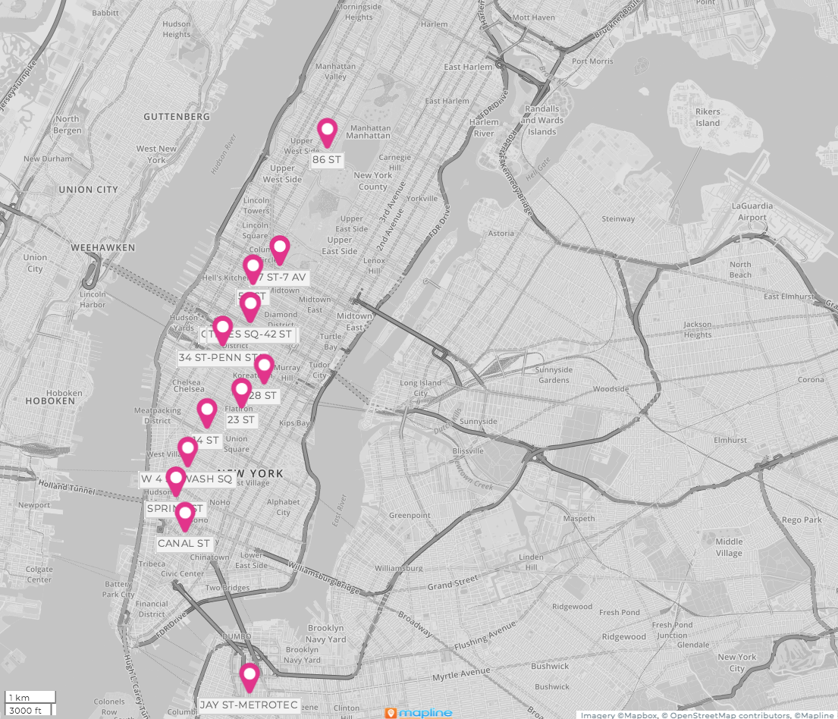
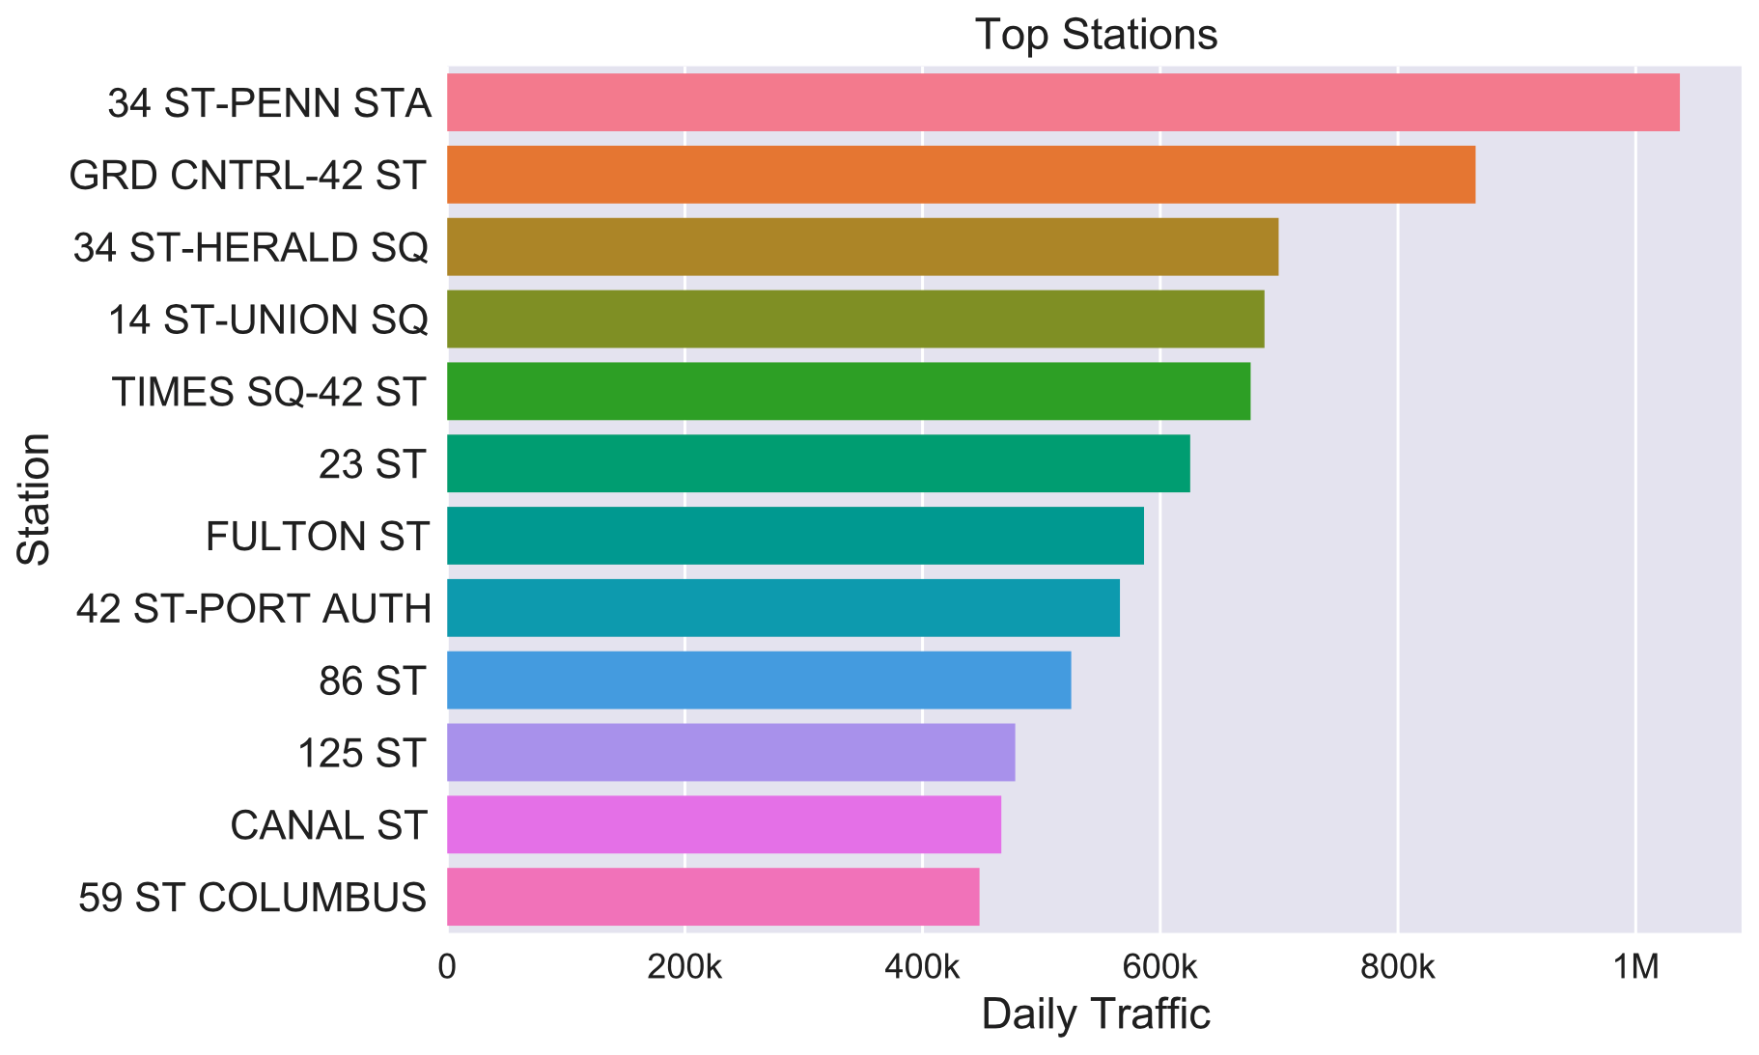
Top busy stations
I think we should still include this slide
It’s also backing up why we chose those 5 stations in the end

Slide 10
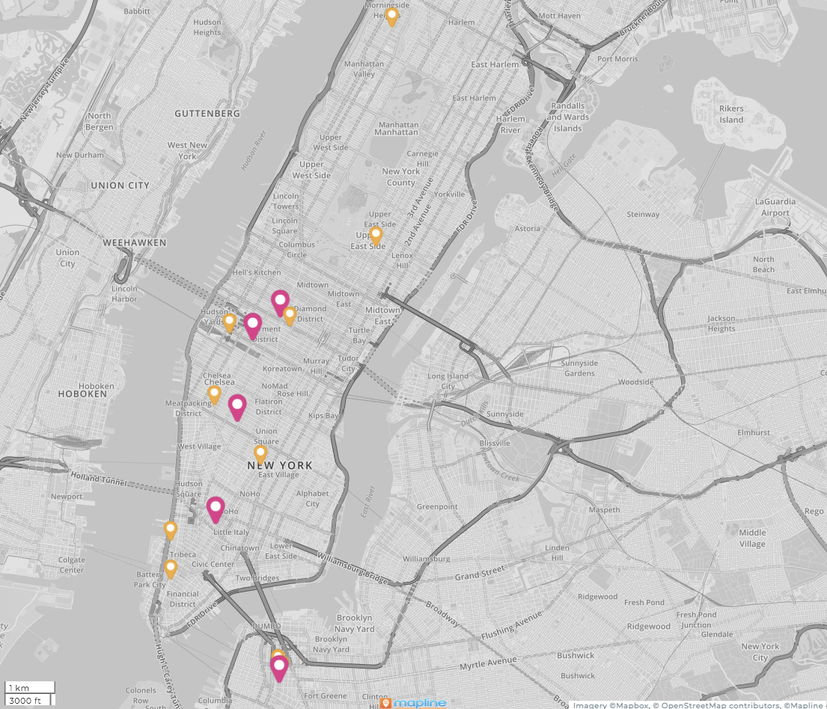
Top busy stations

Slide 11
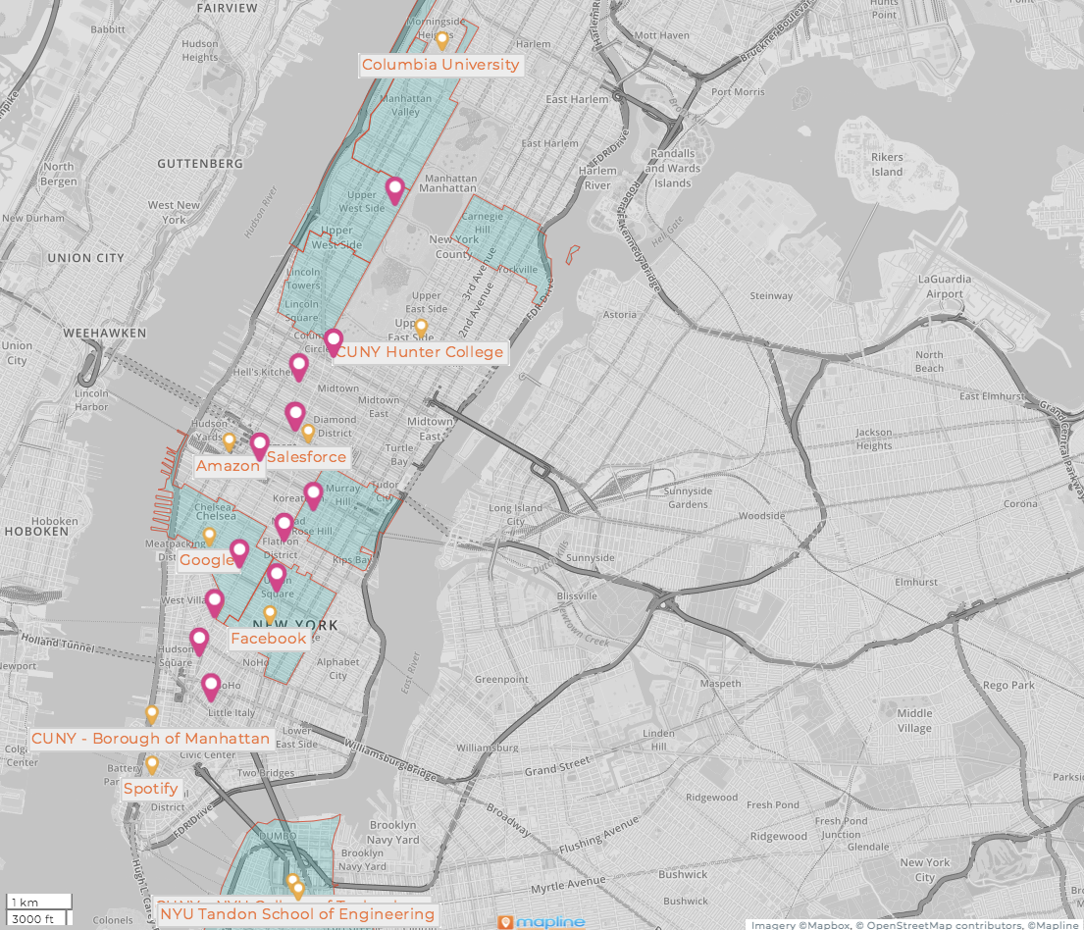
Top 10 busiest stations
Busy stations
Tech
enthusiasts
Income
consideration

Slide 12
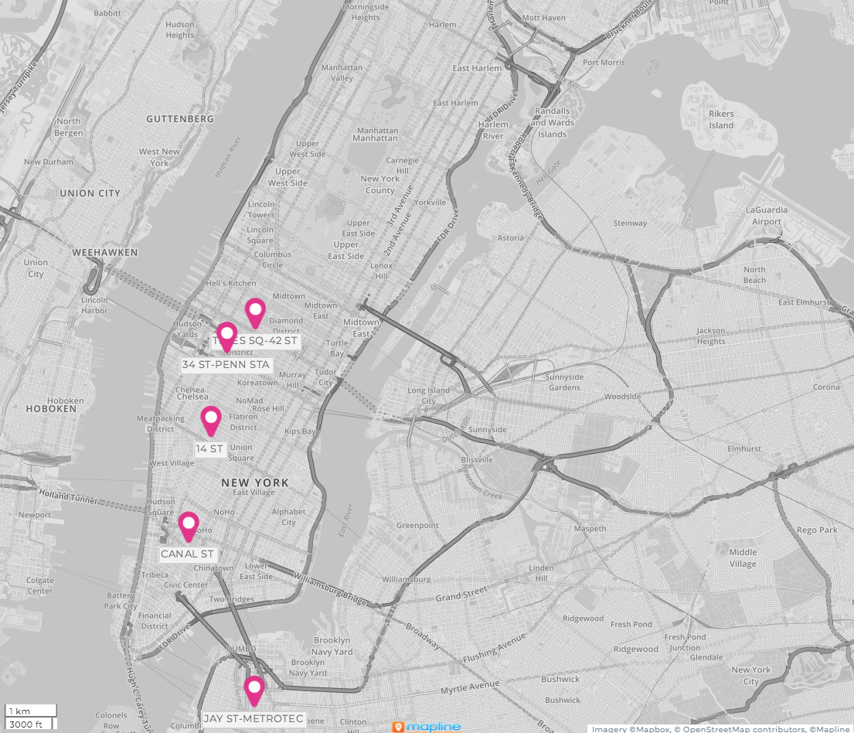
Our target stations
Station Name
34th St - Penn Station
Canal Street
14 St
Jay St - Metro Tech
Time Square

Slide 13
Results
Maps -- Katie
Graphs of station data

Slide 14
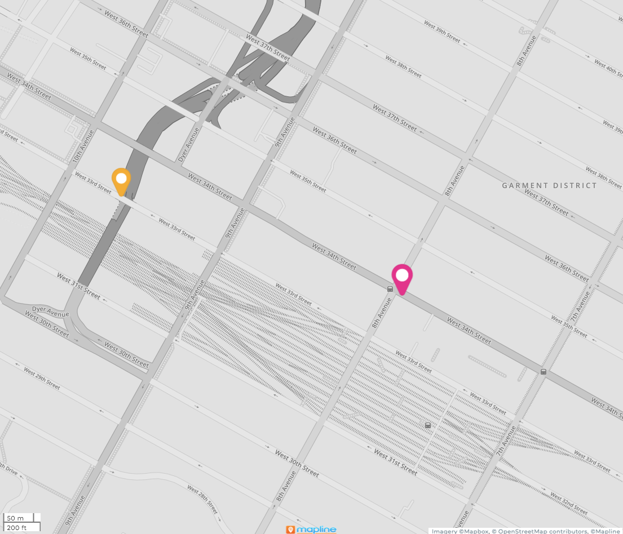
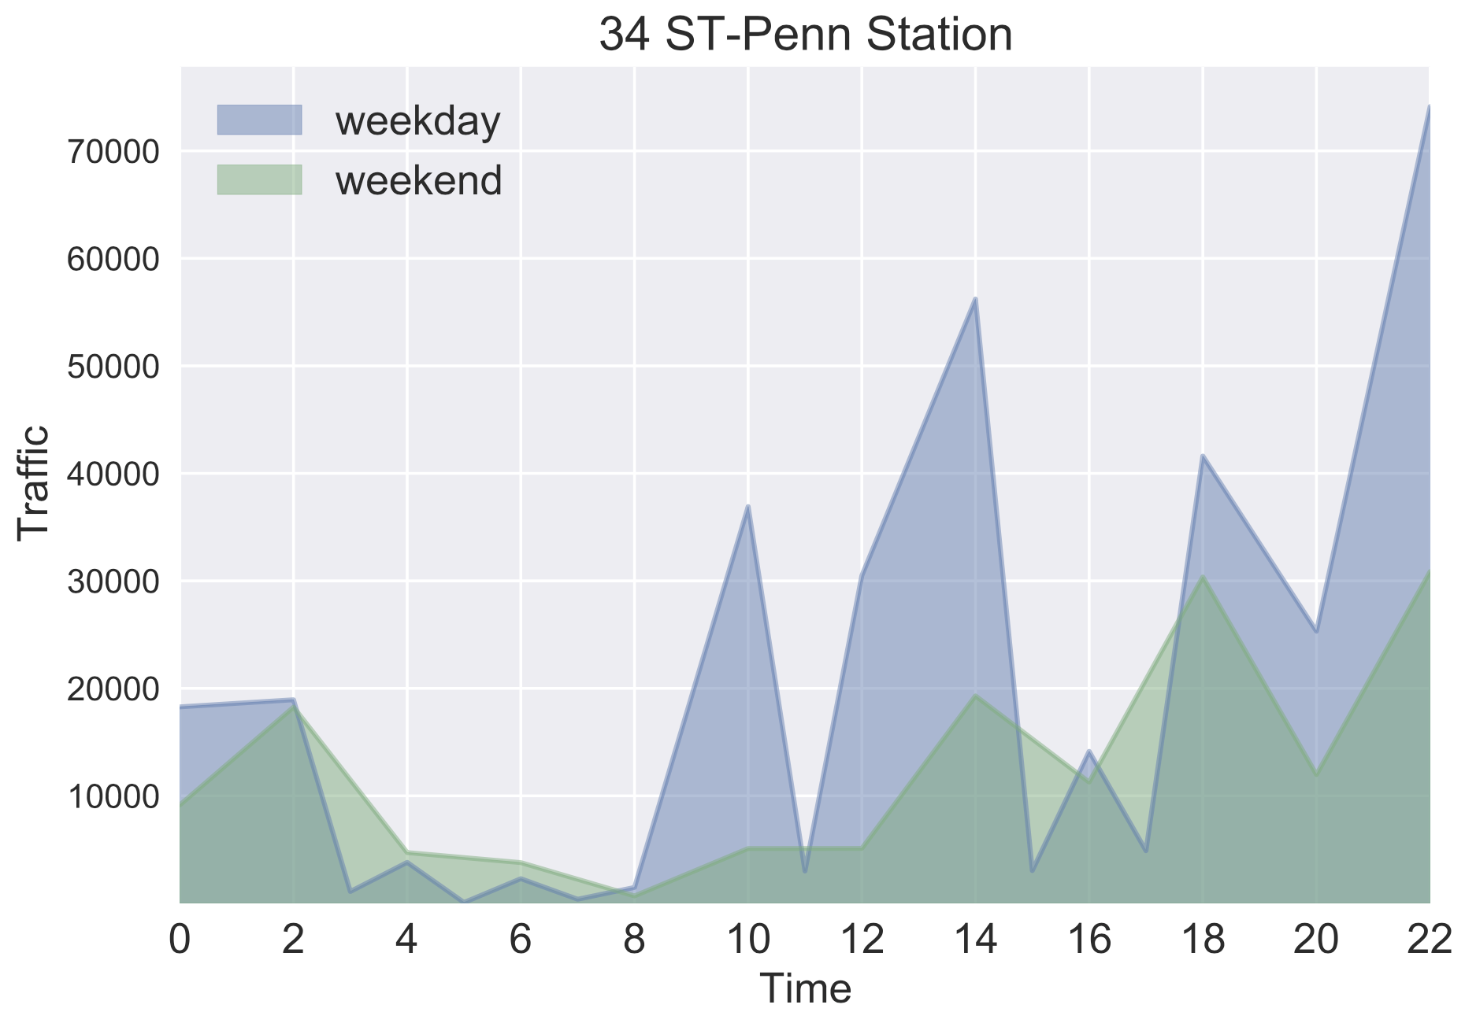
34th - Penn Station
34th - Penn Station
Tuesday - Thursday from 1:00-3:00PM

Slide 15
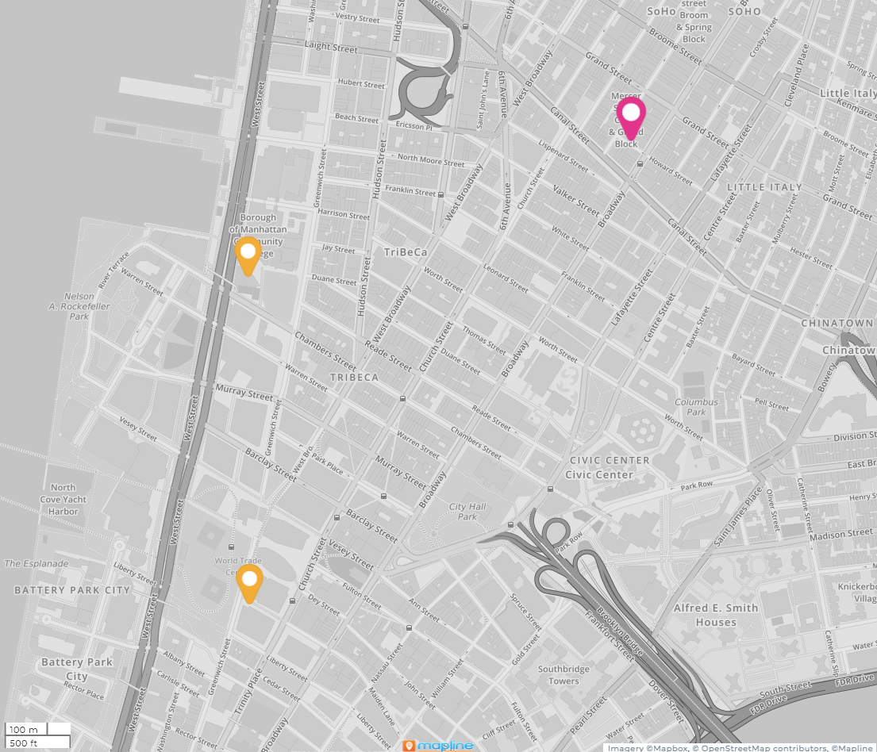
Canal St
Canal St
They r actually quite far from Canal St lol
Wednesday - Friday from

Slide 16
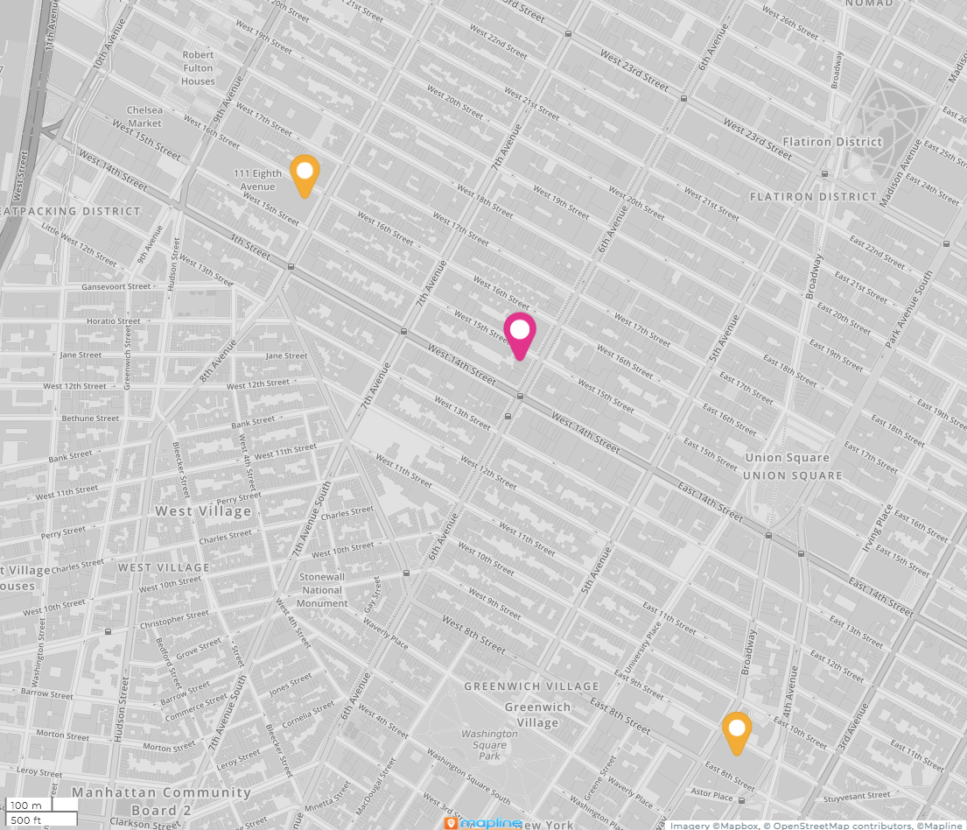
14th St
Tuesday - Friday from
3pm - 6pm
14 St

Slide 17
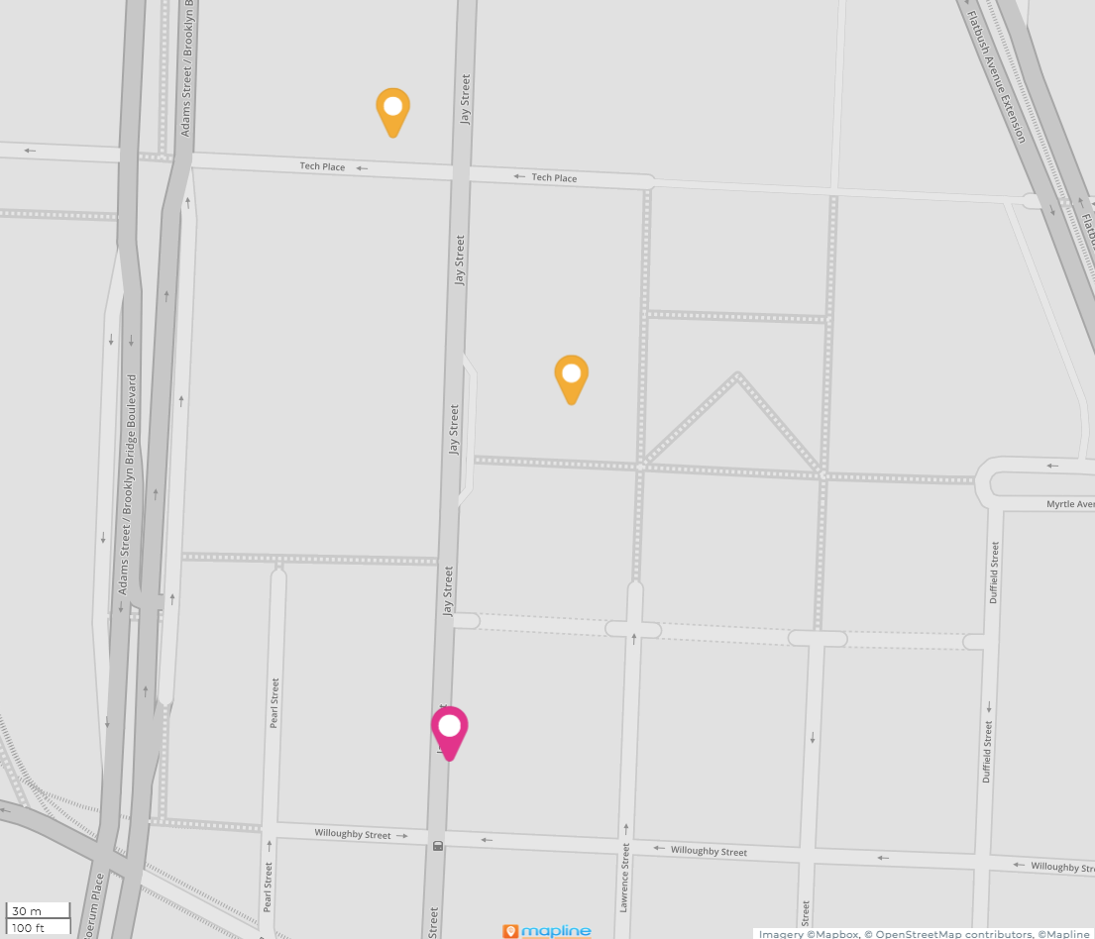
Jay St - Metro Tech
Jay St - Metro Tech

Slide 18
Times Square

Slide 19
Conclusion
Station Name | Nearby | Street Team Staffing
34th St - Penn Station | Amazon | TU,W,TH: Noon - 2pm
Canal Street | Spotify CUNY - Borough of Manhattan
14 St | Google, Facebook
Jay St - Metro Tech | NYU Tandon School of Engineering CUNY - NYU College of Technology
Time Square | Salesforce

Slide 20
Appendix

Slide 21
Data Sources
MTA Turnstile Data for May and June 2018
http://web.mta.info/developers/turnstile.html
MTA Station Information
http://web.mta.info/developers/data/nyct/subway/Stations.csv
MTA Turnstiles-Remote Complex Lookup
https://qri.cloud/nyc-transit-data/remote_complex_lookup
Locations of 5 large tech companies and 5 tech universities
Google Maps
IRS Individual Income Tax Statistics
https://www.irs.gov/statistics/soi-tax-stats-individual-income-tax-statistics-2018-zip-code-data-soi

Slide 22
Nearest NY MTA Station Stops to Selected
Tech Company | Station Name | Borough
Spotify | Canal St | M
Facebook | Astor Place | M
Salesforce | Times Square | M
Amazon | 34 St-Penn Station | M
Google | 14 St | M
University | Station Name | Borough
NYU Tandon School of Engineering | Jay St-MetroTech | Bk
CUNY - NYU College of Technology | Jay St-MetroTech | Bk
CUNY - Borough of Manhattan | Canal St | M
CUNY Hunter College | 68 St-Hunter College | M
Columbia University | 116 St-Columbia University | M

Slide 23
Subset of Aggregated Federal Tax Returns Filed
We considered income brackets of residents near MTA station stops
Extra income for a night out and to make a voluntary monetary contribution
This a portion of our total aggregated table
Zip Code | Returns Filed > 75K * | Number of Stations | Borough
10023 | 21,990 | 1 | M
11201 | 20,820 | 6 | Bk
10025 | 20,660 | 4 | M
10128 | 19,380 | 1 | M
10016 | 19,140 | 2 | M
10011 | 18,970 | 5 | M
10024 | 18,600 | 4 | M
11215 | 17,710 | 5 | Bk
10003 | 17,270 | 12 | M
*Data Source: https://www.irs.gov/statistics/soi-tax-stats-individual-income-tax-statistics-2018-zip-code-data-soi

Slide 24
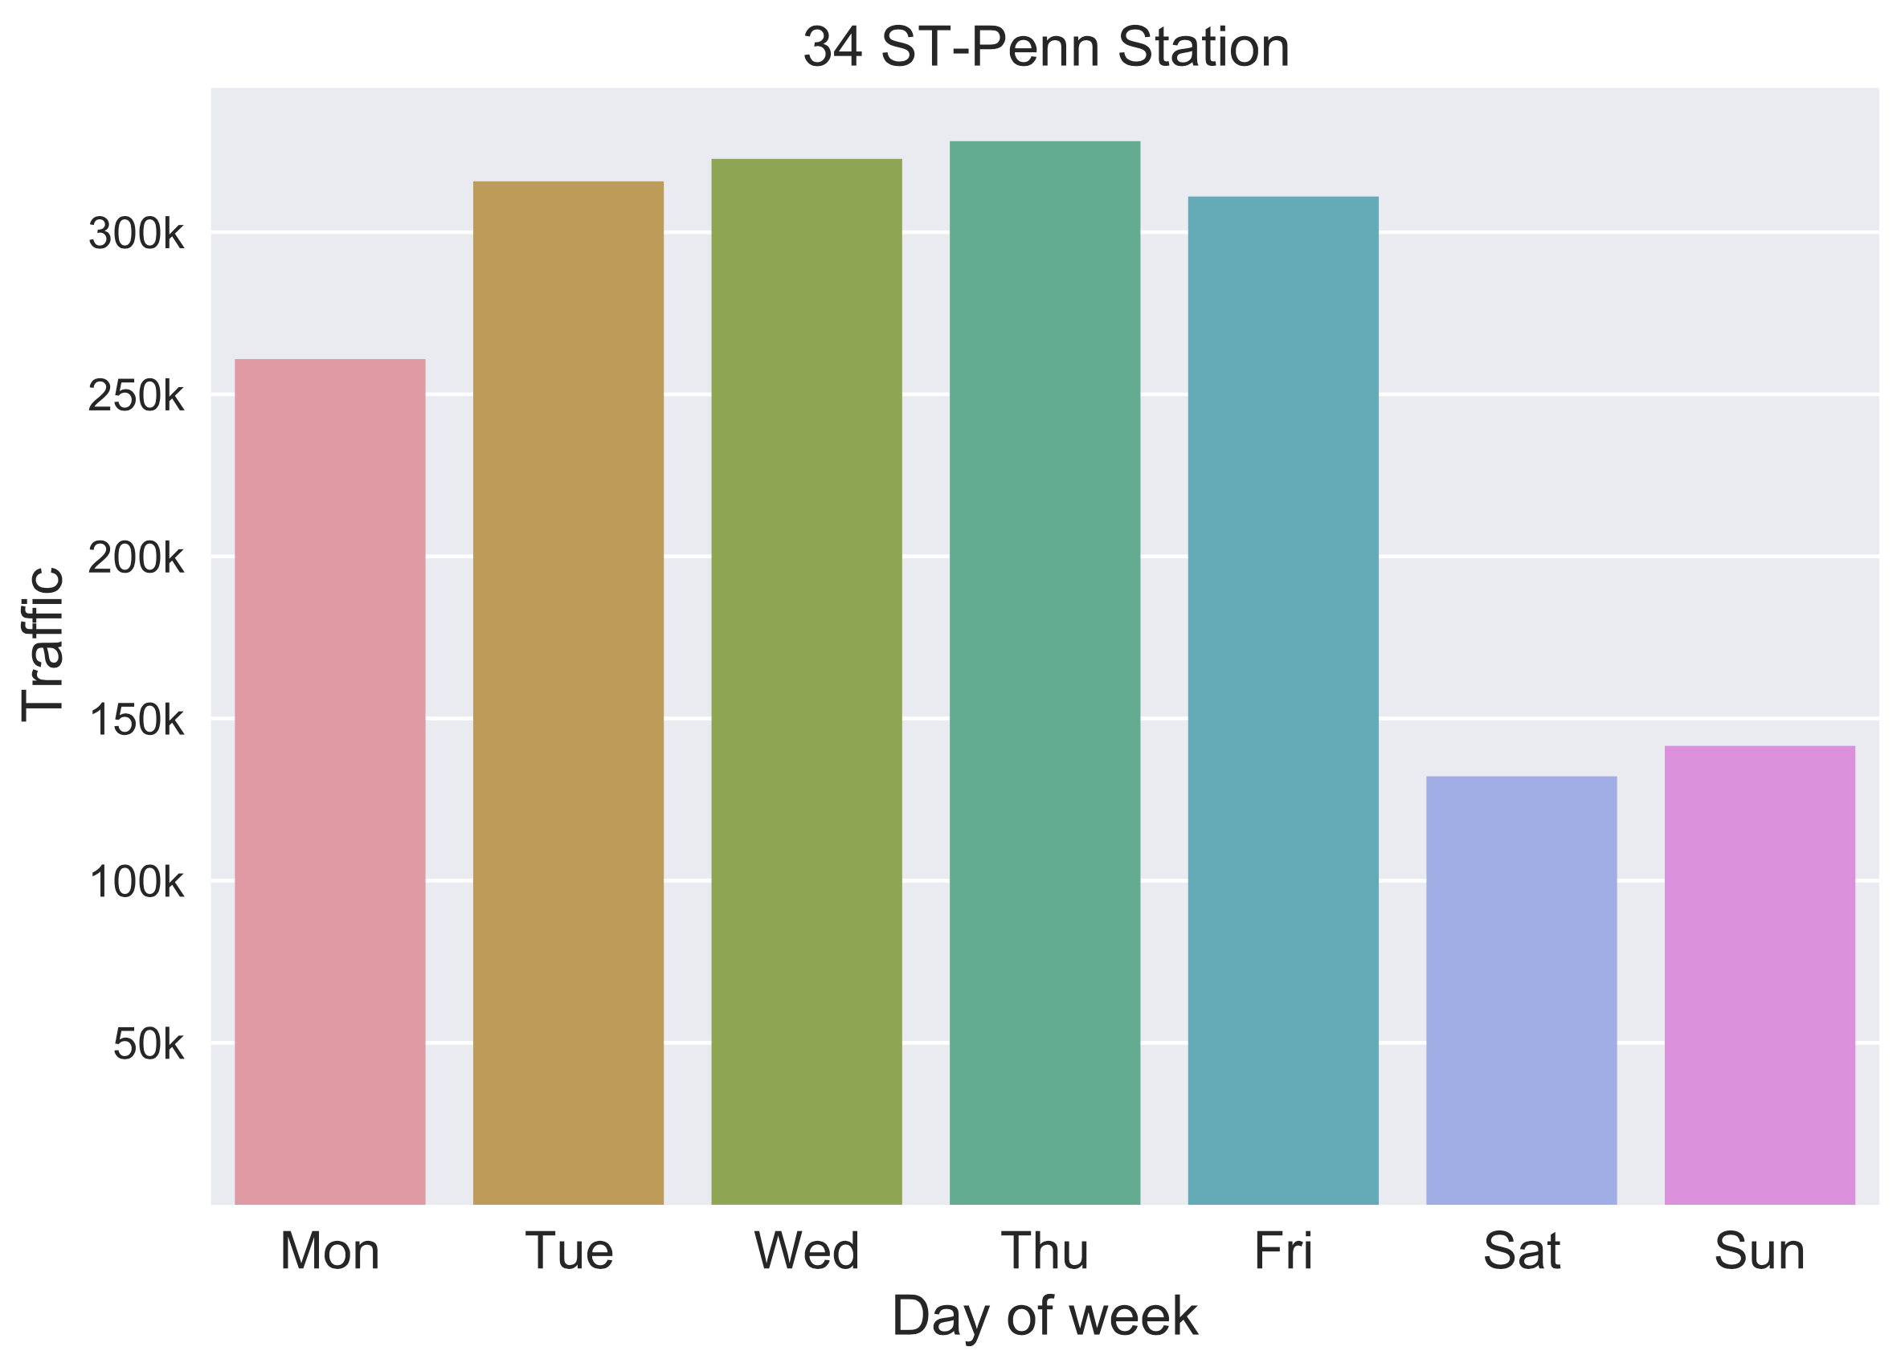
Busiest hours
One of the target station (Penn Station) daily traffic throughout the week:
Weekdays > weekends
Different peak hours

Slide 26
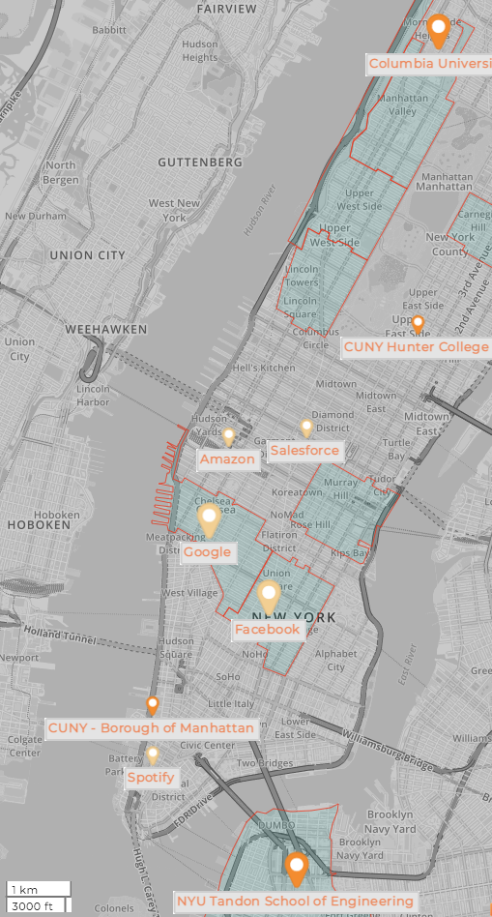

Slide 27
Who loves galas?

Slide 28
Top busy stations
MTA traffic for early summer in 2018 (2019?)
Bar chart race

Slide 29
Need interaction?
START

